Slide 1

Securing Cloud Computing
Advantages and Disadvantages of cyber security in the Cloud

Slide 2

Advantages of Cloud Computing
Scalable and flexibility
Faster Deployment
Reduced Cost
Reduced Latency
Low risk of failure

Slide 3
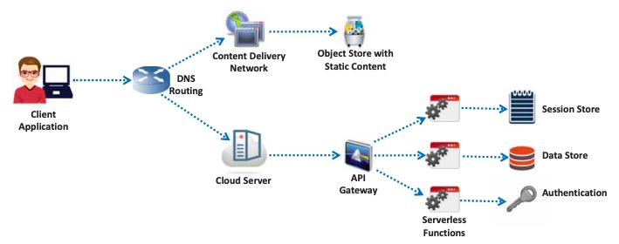
Disadvantages of Cloud Computing
Copyright © by EC-Council. All Rights Reserved. Reproduction is Strictly Prohibited.
    Increased security vulnerability
    Vendor lock-in
    Complex end-to-end application testing
    Not suitable for all tasks, such as long-term serverless computing

Slide 4

Cloud Computing Threats
Accountability and Data Ownership
Vendor lock-in
Regulatory Compliance
User Privacy and Secondary Usage storage of Data
Multi-Tenancy and Physical Security
User Identity Federation (Provisions for Offboarding)

Slide 5

Cloud Computing Threats Security Weakness
SQL Injection
OS Command Injection
Log monitoring not in place
Security misconfiguration
Sensitive data not encrypted
Coding errors
Over provisioning of permissions
Cross-Site Scripting (XSS)

Slide 6

Cloud Computing Threat Mitigation
Encrypt all data
Strong registration and validation process
Strong Key Generation and Storage
Monitor all client traffic for malicious activities
Data protection must be part of the design process
Exit plan created in design phase
Effective Acceptable Use Policy

Slide 7

Cloud Computing Threat Mitigation (Cont’d)
Enforce strict supply chain management
Human resource requirement as part of the legal contract
Transparency in compliance reporting
Clearly identified security breach notification process
Regular implementation of software updates
Regular Data backups
Effective business continuity disaster plan in effect

Slide 8
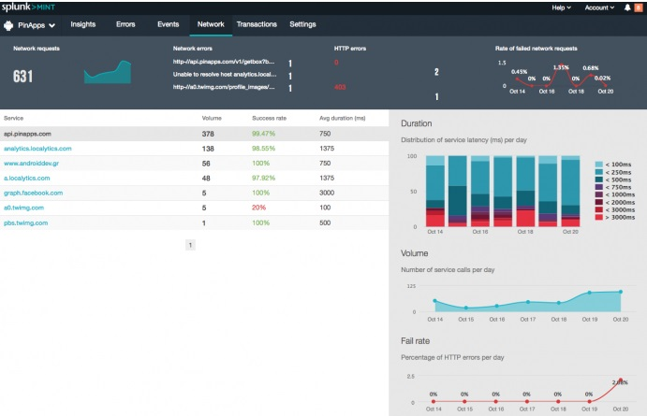
Cloud Computing Threat Mitigation
Active Network Traffic Analysis
Isolation of memory, storage, and network access
Copyright © by EC-Council. All Rights Reserved. Reproduction is Strictly Prohibited.

Slide 9
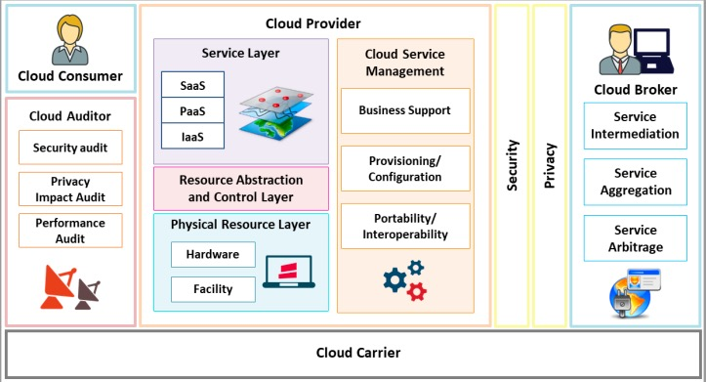
Cloud Computing Threat Mitigation Management
Select Cloud Provider from a reputable provider with long track of performance
Ensure Service Level Agreement meets the needs of the organization
Copyright © by EC-Council. All Rights Reserved. Reproduction is Strictly Prohibited.

Slide 10
CEHv13 Update – Cloud Threats & Hacking Techniques
CEHv13 expands coverage of:
  Container and Kubernetes exploitation (e.g., insecure APIs, misconfigured roles)
  Serverless abuse: unrestricted code execution, hidden persistence via functions
  Credential theft from cloud metadata services (e.g., SSRF in AWS)
  Use of cloud-specific MITRE ATT&CK mappings (e.g., Initial Access via exposed IAM tokens)
Emphasis on abusing:
  Misconfigured object storage (e.g., AWS S3)
  Federated identity and offboarding weaknesses
  Overly permissive IAM roles across cloud providers

Slide 11
CEHv13 Update – Cloud Defense & Best Practices
CEHv13 recommends:
  Multi-cloud security posture management (CSPM) to track config drift
  Use of least privilege IAM policies and identity federation auditing
  Real-time monitoring of API and user traffic
Framework-aligned strategies:
  Encrypt all cloud-stored data
  Include security controls in CI/CD pipeline deployments
  Cloud-native defense tools: AWS GuardDuty, Azure Defender, GCP Security Command Center

Slide 12

Cryptography Objectives
Confidentiality
Integrity
Authentication
Nonrepudiation

Slide 13
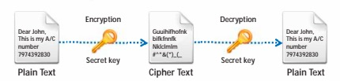

Encryption Types
Symmetric Encryption
Both sender and receiver must have the same encryption key
Asymmetric Encryption
The public key is available however the private key remains with the owner of the key
Copyright © by EC-Council. All Rights Reserved. Reproduction is Strictly Prohibited.

Slide 14

Encryption Type Strengths
Symmetric Encryption | Asymmetric Encryption
Easier to implement as the same key is used for encryption as well as decryption | Convenient to use, as the distribution of keys to encrypt messages is not required

Slide 15

Encryption Type Symmetric Weaknesses
Symmetric Encryption
Lack of secure channel to exchange secret key
Difficult to manage many keys
No assurance of message origin
Vulnerable to dictionary attacks

Slide 16

Encryption Type Asymmetric Weaknesses
Asymmetric Encryption
Requires high processing power
Private key, if compromised, can allow anyone with the key to read messages
Vulnerable to man-in-the-middle and brute-force attacks

Slide 17
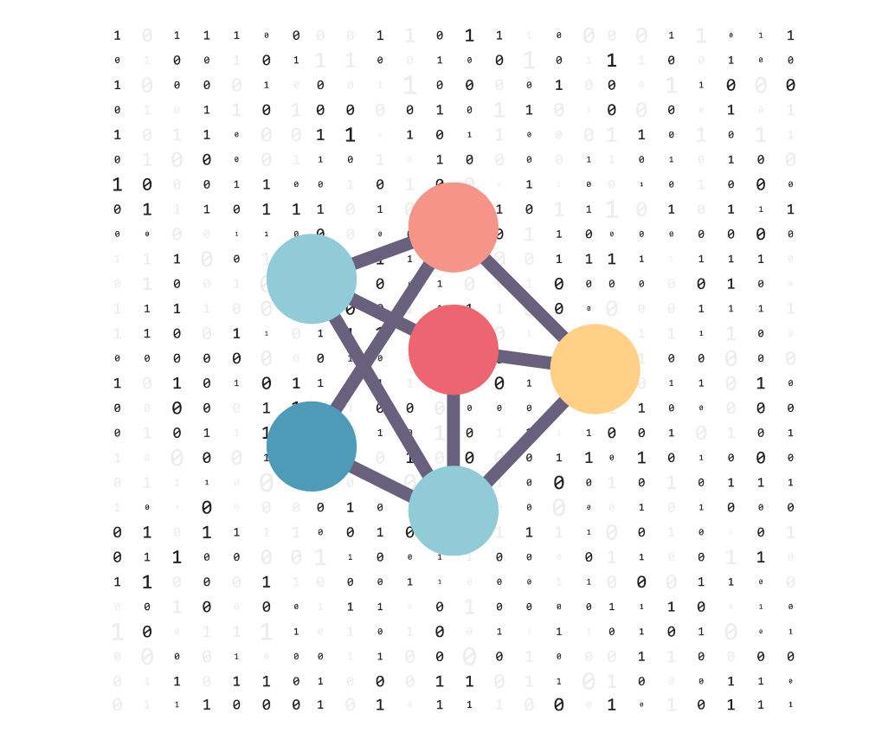
Encryption Algorithms
DES
AES
RC4-6
DSA
RSA
MD5
SHA
..and many more

Slide 18
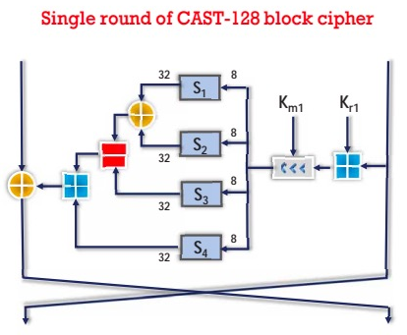
Encryption Algorithms DES
Data Encryption Standard: The (DES) uses a secret key for both encryption and decryption
DES uses a 64 bit key of which 9 bits are reserved for error detection
DES provides for ~72 quadrillion possible encryption keys.
The various versions of DES such as 3 DES in which the encryption process is completed 3 times
Copyright © by EC-Council. All Rights Reserved. Reproduction is Strictly Prohibited.

Slide 19
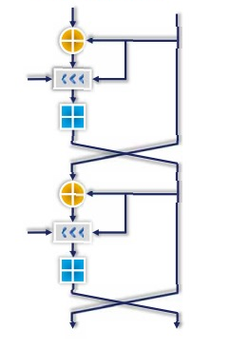
Encryption Algorithms RC5
RC5 is a fast symmetric-key block cypher; the algorithm implements a variable block size ranging from 32 to 128 bits
The encryption routine is based on 3 fundamental operations
  Integer addition
  Bitwise XOR
  Variable rotation
RC5 Algorithm
Copyright © by EC-Council. All Rights Reserved. Reproduction is Strictly Prohibited.

Slide 20

Encryption Algorithms Blowfish
Blowfish uses a symmetric block algorithm and uses the same secret key to encrypt and decrypt data
The Blowfish block length is 64 bits and produces keys from 32 to 448 bits
Algorithm based on two parts
  First part handles expansion key
  Second part encrypts the data

Slide 21
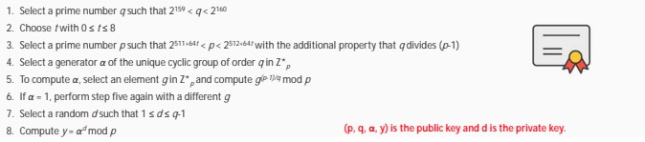
Encryption Algorithms Digital Signature Algorithm (DSA)
Federal standard processing for digital signatures for classified and non-classified data
DSA creates a 320-bit digital signature with 512 – 1024-bit security
Two parts
  First part is the signature generation process
  Second part is the signature verification process
Copyright © by EC-Council. All Rights Reserved. Reproduction is Strictly Prohibited.

Slide 22
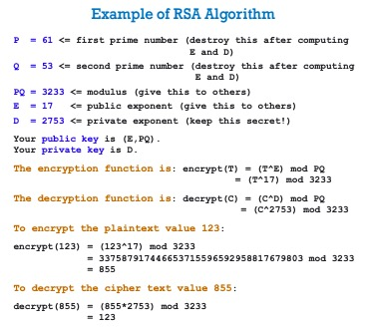
Encryption Algorithms Rivest Shamir Adleman (RSA)
Used primarily for Internet Encryption, considered a standard
DSA creates a 320-bit digital signature with 512–1024-bit security
The DSA standard process goes through six different steps to encrypt data
Copyright © by EC-Council. All Rights Reserved. Reproduction is Strictly Prohibited.

Slide 23
CEHv13 Update – Emerging Cryptographic Threats
CEHv13 highlights:
  Quantum computing’s impact on RSA, ECC, and traditional encryption
  Attacks on blockchain-based authentication and smart contracts
  Use of AI to crack weak encryption patterns
  Growing importance of hybrid cryptographic models (e.g., lattice-based, NIST PQC candidates)
Emphasis on:
  Insecure key management in mobile/cloud environments
  Risks of algorithm misuse, improper padding, or custom crypto

Slide 24
CEHv13 Update – Secure Crypto Implementation
CEHv13 recommends:
  Using only vetted algorithms (AES, RSA, ECC) and avoiding custom schemes
  Storing keys securely via HSMs, TPMs, or encrypted software vaults
  Verifying proper use of:
    SSL/TLS (with modern cipher suites)
    Hashing (e.g., SHA-256+, bcrypt, Argon2) for passwords
Aligns with:
  NIST 800-175B for cryptographic key management
  OWASP Cryptographic Storage guidelines

